Slide 1
Leadership Training in Higher Education: Supervisory Enhancement to Drive Employee Engagement Barbara Packer-Muti, EdD Meline Kevorkian, EdD

Slide 2
Nova Southeastern University
Expected Outcomes:
To describe the components of a successful leadership training program in higher education
To identify the components of an effective assessment plan
To correlate improvements of employee engagement & enhanced leadership skills for supervisors in higher education
To identify collaborative partners within a higher education institution to effect cultural change
To consider unexpected positive outcomes of leadership training across diverse constituent groups

Slide 3
NOVA SOUTHEASTERN UNIVERSITY
18 centers, colleges and schools and 16 administrative units

Slide 4
18 Centers, Colleges and Schools
Nova Southeastern University
Farquhar College of Arts and Science
H. Wayne Huizenga School of Business and Entrepreneurship
Graduate School of Computer and Information Sciences
Oceanographic Center
Shepard Broad Law Center
College of Osteopathic Medicine
College of Pharmacy
College of Optometry
College of Nursing
College of Health Care Sciences
College of Medical Sciences
College of Dental Medicine
Abraham S. Fischler School of Education
Center for Psychological Studies
Graduate School of Humanities and Social Sciences
Mailman Segal Center for Human Development
Institute for the Study of Human Service, Health and Justice
University School
+16 Administrative Units

Slide 5
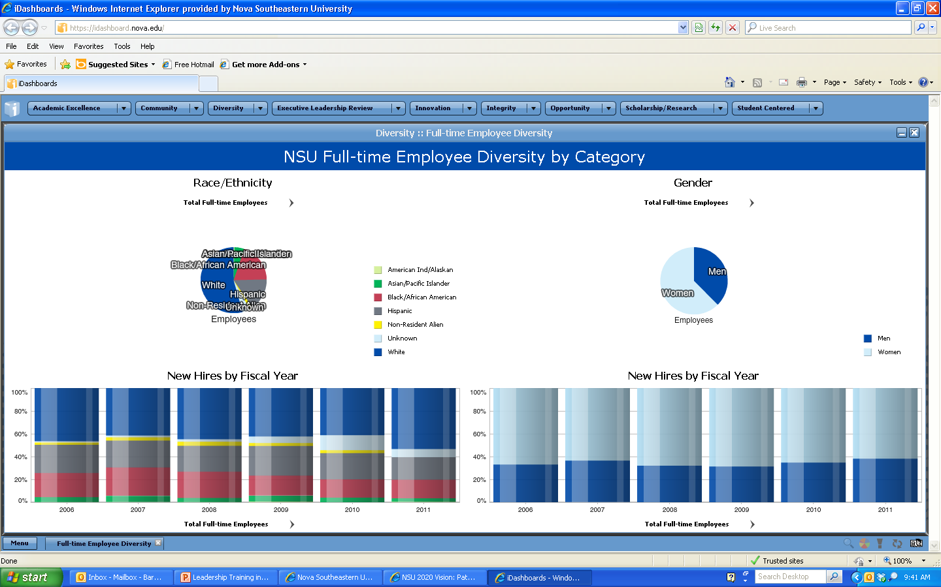
Full Time: 4015
Adjuncts: 857
Supervisors: 600

Slide 6
Vision Statement Adopted by Board – March 28, 2011
Nova Southeastern University
By 2020, through excellence and innovations in teaching, research, service and learning, Nova Southeastern University will be recognized by accrediting agencies, the academic community, and the general public, as a premier private not-for-profit university of quality and distinction that engages all students and produces alumni who serve with integrity in their lives, fields of study, and resulting careers.

Slide 7
Mission Statement Adopted by Board – March 28, 2011
The Mission of Nova Southeastern University, a private, not-for-profit institution, is to offer a diverse array of innovative academic programs that complement on-campus educational opportunities and resources with accessible distance learning programs to foster academic excellence, intellectual inquiry, leadership, research, and commitment to community through engagement of students and faculty members in a dynamic, life-long learning environment.

Slide 8
Core Values Adopted by Board
– March 28, 2011
Academic Excellence
Student Centered
Integrity
Innovation
Opportunity
Scholarship/Research
Diversity
Community

Slide 9
Historical/Cultural Background Information
Why go to the trouble of designing & implementing leadership training?

Slide 10
Engaged employees are more than satisfied and more than committed; they are emotionally connected.
They go out of their way to over-achieve. They actively promote your business. They stay with you during good times and bad.
Put simply, engaged employees are more productive –
and more profitable.
What is Engagement?
`
Advocacy
Engagement
`
Discretionary Effort
`
Intent to Stay
Notes:
Quantum Workplace has elaborated a simple, yet potent, Engagement Model. We call it “Say, Stay, & Strive”.
In short, the survey was developed to measure three primary components of Employee Engagement.
1. Advocacy – Do employees think and speak highly of the organization – its leaders, managers, employees, products, quality and future outlook?
2. Intent to Stay – Do employees want to be a part of the organization?
3. Discretionary Effort –Do employees think of ways to do their jobs better, improve service delivery and operational efficiency?

Slide 11
Assessment Data
Employee Engagement Studies (‘07 – ’09)
07 08 09
Supervisor Cares about Me 4.03 4.06 4.04
Opinions Count 3.55 3.60 3.57
Open Communication 2.69 2.89 2.86
Share Views 3.02 3.17 3.20
Trusting/Open Environment 3.72 3.66 3.69
Co-workers well-informed 3.32 3.40 3.34
Recognition 3.03 3.27 3.21

Slide 12
Response Rate
73.6%
In 2011, we invited 4,383 staff to provide feedback on the workplace experience. A total of 3,228 did.
A 73.6% response rate represents a strong effort.

Slide 13
Survey Snapshot 2011
Employees Surveyed | (N=4383)
Administration Dates | September 12 - October 3, 2011
Content | 47 Items across 15 Categories
 | -27 "Best Places" Benchmarks
 | -4 Open-Ended Comments
Demographics | Age [6]
 | Tenure [6]
 | Center [43]
 | Full-Time/Part-Time [2]
 | Gender [2]
 | Supervisor [260]
Analytics | Response Distribution
 | Engagement Drivers
 | Benchmarking Analysis

Slide 14
Town Hall Meetings
 | # of Meetings | Approximate # of Attendees
2009 | 54 | 2001
2010 | 59 | 2011
2011 | 36 | 2365
TOTAL:

Slide 15
Town Hall Meeting Themes (Qualitative Analysis)
 | HR/ TRAINING POLICIES/ BENEFITS | FACILITY& SAFETY | STUDENT RECRUITMENT & RETENTION | COMMUNICATION | TECHNOLOGY | OTHER | FACULTY/ STAFF DEVELOPMENT | RECOGNITION& SATISFACTION | COLLABORATION
Mailman Segal Center | 4 | 5 | 0 | 1 | 0 | 1 | 0 | 0 | 1
Shepard Broad Law | 1 | 1 | 0 | 3 | 3 | 3 | 3 | 0 | 0
Health Care Sciences | 3 | 3 | 2 | 1 | 2 | 2 | 2 | 1 | 0
FSE | 16 | 11 | 4 | 2 | 4 | 2 | 3 | 2 | 0
GSCIS | 1 | 0 | 0 | 0 | 1 | 0 | 0 | 1 | 1
Optometry | 8 | 13 | 3 | 3 | 1 | 4 | 2 | 0 | 0
Osteopathic Medicine | 0 | 5 | 5 | 1 | 4 | 1 | 3 | 0 | 0
Dental Medicine | 43 | 13 | 3 | 13 | 5 | 11 | 4 | 8 | 0
Medical Science | 9 | 2 | 1 | 3 | 3 | 1 | 0 | 1 | 0
University School | 10 | 5 | 7 | 1 | 2 | 0 | 1 | 0 | 1
SBE | 3 | 1 | 5 | 5 | 3 | 8 | 9 | 1 | 1
FCAS | 4 | 13 | 4 | 0 | 2 | 3 | 4 | 0 | 0
Pharmacy | 7 | 7 | 2 | 5 | 9 | 1 | 11 | 1 | 0
Nursing | 0 | 2 | 0 | 4 | 0 | 2 | 1 | 0 | 0
Total: | 109 | 81 | 36 | 42 | 39 | 39 | 43 | 15 | 4

Slide 16
Documentation/samples of employee engagement
Surveys and Town Hall Meetings

Slide 17
Leadership role in staff's daily life is critical to engagement.
Elements of recognition drive engagement.
Fulfillment of individual strengths as mentored by supervisors drive engagement.

Slide 18
Communication
Communication presents a general opportunity at NSU.
One's own unit's is perceived to perform better than others.
Unfettered communication with the administration is among the most polarized items on the survey. This may represented unequal access or exposure to leadership.
Information flowing from leadership is perceived favorably by some and unfavorably by others.
This item sets "a high bar for agreement". Still, one-third agreed while one-fourth disagreed.

Slide 19
COMMUNICATION: Any issue related to the exchange of information (regardless of modality). Communication issues range from (a) a lack thereof to (b) an overload of to (c) miscommunications.
Communication issues are within units, across units, and from top down and bottom up.
Sub-Categories
fear of reprisal for providing opinion/input
communication delay
communication overload
lack of information
inconsistent information
response time
regular updates from President/Provost/Deans
suggestion boxes
directory
Examples:
Faculty and staff feel that communication is inconsistent. They report only receiving information when there is an
issue that needs to be resolved. Employees report being afraid to express their opinions for fear of reprimand or reprisal, therefore they would like to have meetings where supervisors are not present. Staff would like meetings to be more frequent so that they can communicate in a face-to-face venue.

Slide 20
Comments at a Glance
Respondents who left at least one comment | 2,290 (71%) | 482 respondents left one, 1595 left two, 177 left three, 36 left four.
Respondents who left no comments | 938 (29%) | Three recognition forms. | Desire to stay? | Manager does well. | Manager could improve.
Total number of comments | 4,347 | 124 | 200 | 2,088 | 1,935
Average words per comment | 20.5 | 22.63 | 17.77 | 17.35 | 23.98
Total word count | 88,970 | 2,806 | 3,553 | 36,217 | 46,394
About 356 Pages
Notes:
To get a sense of the amount data contained in the comments, consider that the average novel has about 250 words per page. 88,970 words/250 words per page = 356 pages.

Slide 21
Steps in designing curriculum
Collaboration and Teamwork!

Slide 22
Institutional Effectiveness & Academic Affairs
Task Force Appointed by President
Syllabi Review (internal)
External Trainers & Materials
Qualitative Analysis of Themes
Decisions about Learning Outcomes
Grouped into Five (5) Modules
Preliminary Facilitators Chosen
Leadership Curriculum Committee Meetings
Assessment Decisions

Slide 23
Budget and Timelines
How much does this training cost? When did it start and when will it end?

Slide 24
Annual Budget
Module Title | Average attendees per session | Facilitator Fee per session | Cost of Materials per session | Cost of Catering per session | Room Set-up cost | Number of sessions needed | Total costs per session | Total costs for all supervisors to attend | Cost per Attendee
Managing Conflict/Change | 50 | 600.00 | 100.00 | 900.00 | 200.00 | 14 | 1,800.00 | $25,200.00 | 36.00
Communication | 50 | 600.00 | 100.00 | 900.00 | 200.00 | 14 | 1,800.00 | $25,200.00 | 36.00
Performance Management and Legal Issues for Supervisors | 50 | 600.00 | 100.00 | 900.00 | 200.00 | 14 | 1,800.00 | $25,200.00 | 36.00
Leadership Visioning & Planning | 50 | 600.00 | 100.00 | 900.00 | 200.00 | 14 | 1,800.00 | $25,200.00 | 36.00
Measurement/Project Management | 50 | 600.00 | 100.00 | 900.00 | 200.00 | 14 | 1,800.00 | $25,200.00 | 36.00
Totals |  | 3,000.00 | 500.00 | 4,500.00 | 1,000.00 | 70 | 9,000.00 | $126,000.00 | 180.00

Slide 25
Curriculum Development
Further design
Pilot program
Mar 2009
Jul
Nov
Mar 2010
Jul
Nov
Mar 2011
Jul
Nov
Mar 2012
Jul
Assignment of Facilitators
Program began
Meeting with Leadership & Appointment of task force
' 09
' 12

Slide 26
Five Content Modules
So, what are we teaching?

Slide 27
Managing Conflict & Change Facilitators: From Conflict Mediation Program
Identify components of an effective change plan
Develop strategies for overcoming obstacles to change
Describe motivation strategies to help employees adjust to change
Develop an assessment tool to measure the effectiveness of a change plan
Describe ethical considerations when managing conflict or change in the work place

Slide 28
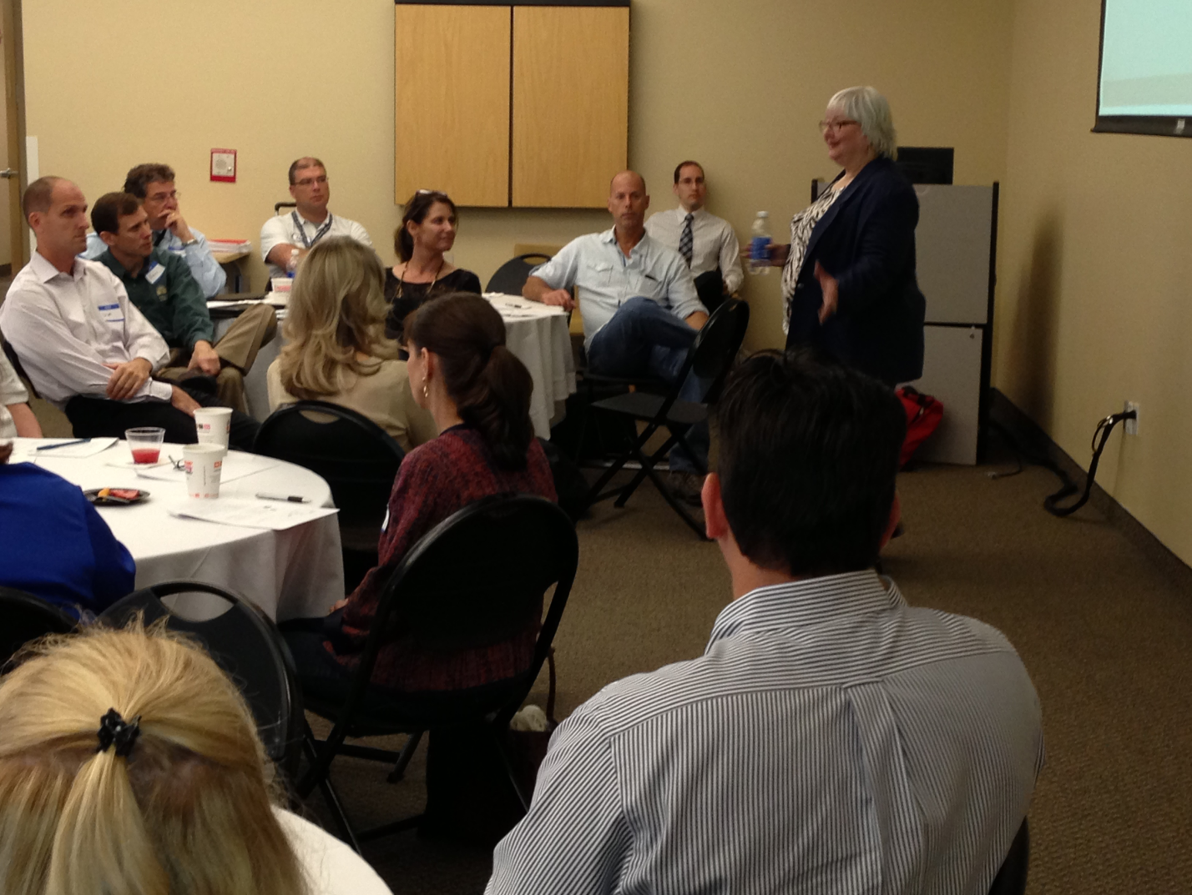

Slide 29
Communication Skills Facilitators: From Speech-Language, Liberal Arts, & Education
Demonstrate the technique of active listening.
Demonstrate the ability to provide information effectively both verbally and in writing.
Describe barriers to effective communication.
Identify strengths and weaknesses in providing feedback to supervisees
Describe ways to collaborate in the workplace.
Identify Interpersonal skills that enhance communication in the workplace

Slide 30
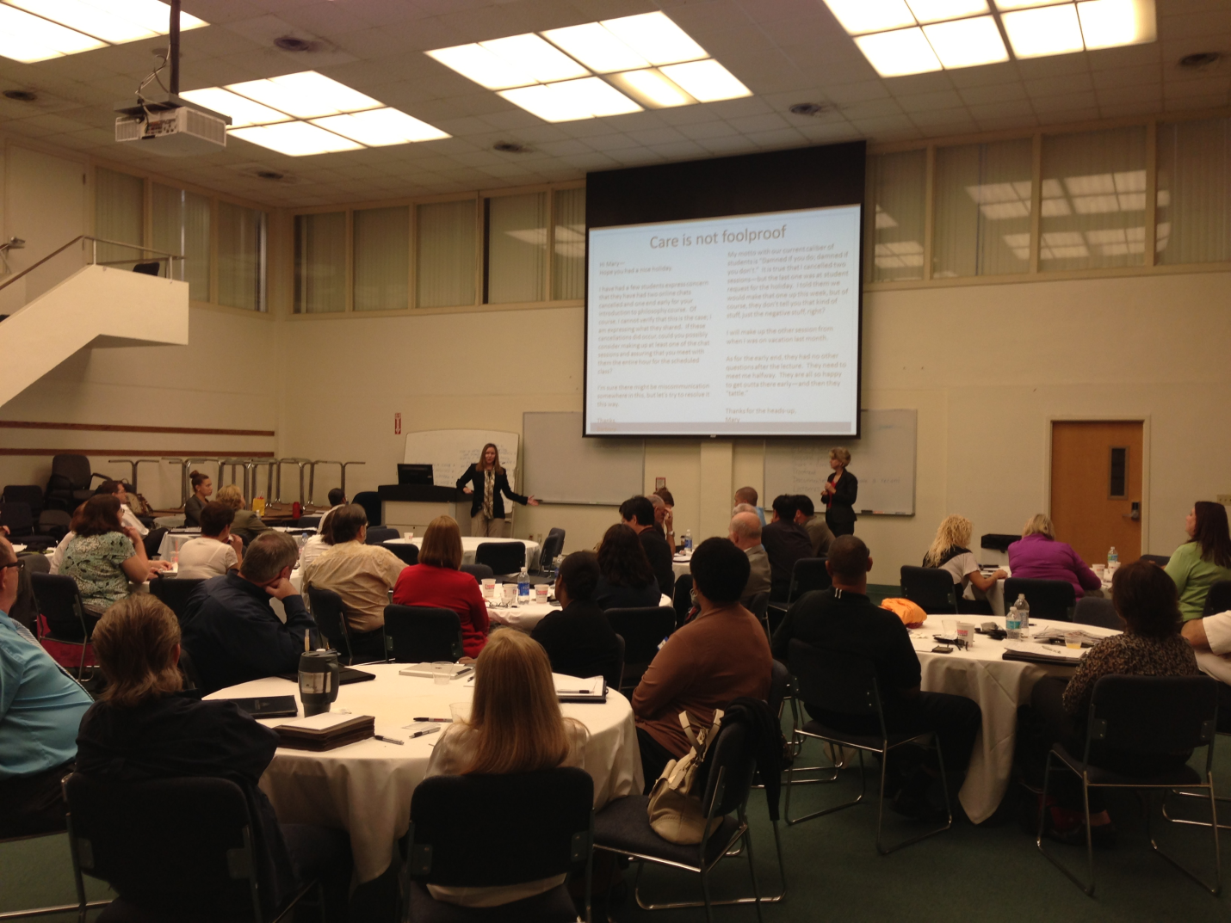

Slide 31
Performance Management Facilitators: Human Resources & Legal Counsel
Identify potential issues that could lead to potential legal employment risk situations
Identify the steps in working with the office of human resources when potential legal employment situations arise
Identify strategies to effectively coach and empower employees
Describe motivation strategies for enhanced employee performance
Describe best practices in developing a corrective action plan
Identify various means of rewarding employees and providing employee recognition
Describe considerations in determining appropriate delegation of tasks
Articulate a personal management philosophy in concert with NSU’s values and 2020 vision

Slide 32
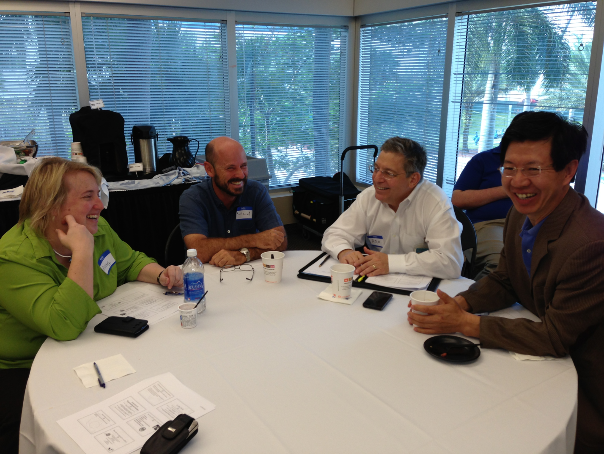

Slide 33
Measurement & Project Management Facilitators: Business School & Pharmacy
Identify the steps in project planning and risk analysis
Describe the steps in project scheduling to include detailing benchmarks and timelines
Describe considerations in resource allocation
Identify methods to document activities related to projects
Provide a variety of appropriate metrics for measuring change as a result of project implementation (e.g., Six Sigma and others)

Slide 34
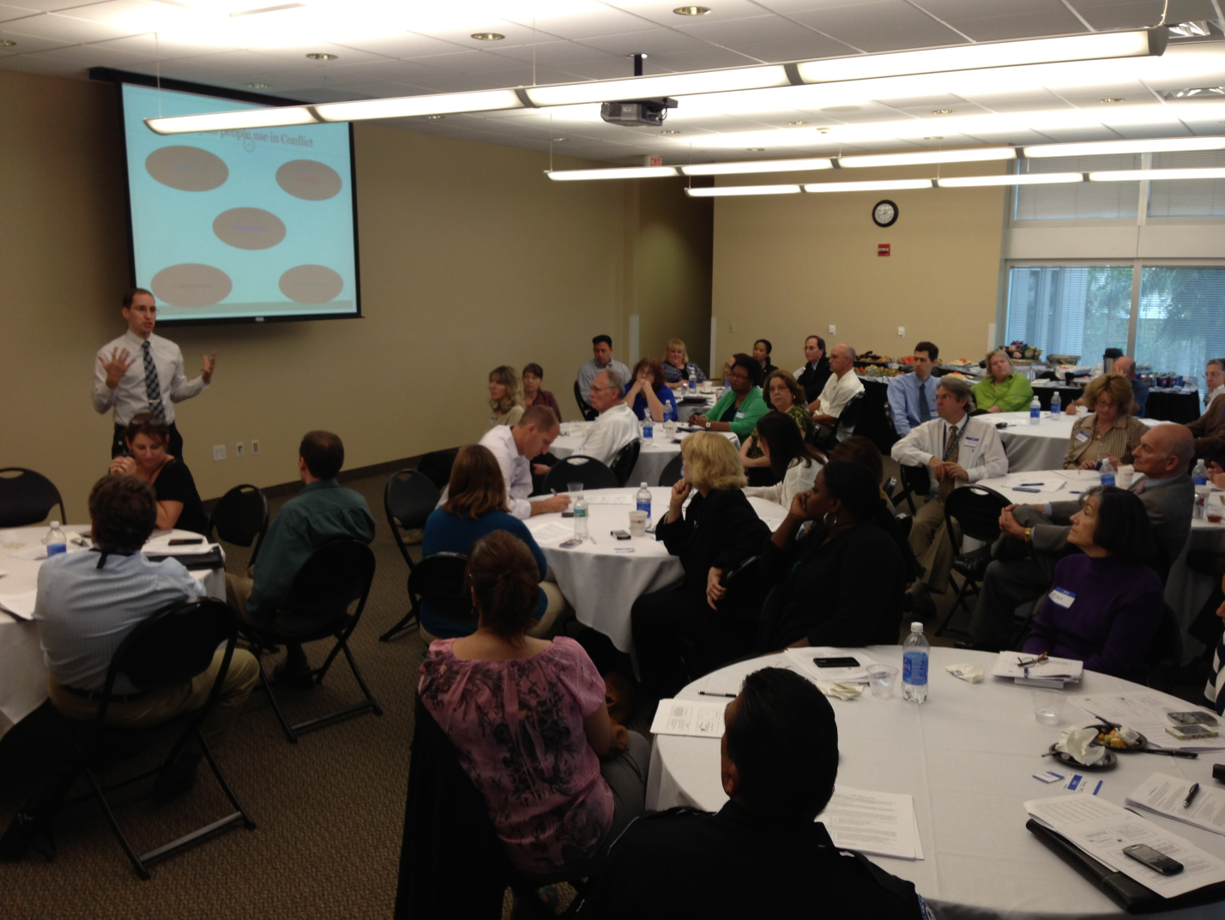

Slide 35
Leadership Visioning & Planning Facilitators: Institutional Effectiveness & University School
Develop plans in accordance with the 2020 Vision Statement
Identify the steps in effective strategic planning
Provide examples of best practices in team building
Describe the steps in effective problem solving
Identify factors in effective decision making

Slide 36
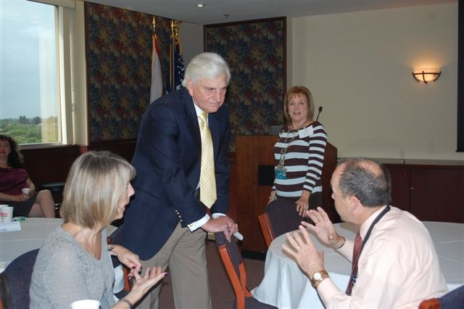

Slide 37
Assessment plan & Tools
How do we know it’s working?

Slide 39
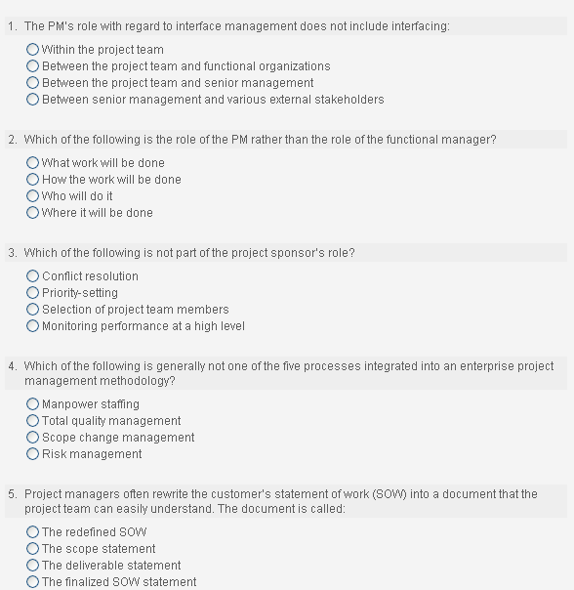
Pre/Post Test
Project Management

Slide 40
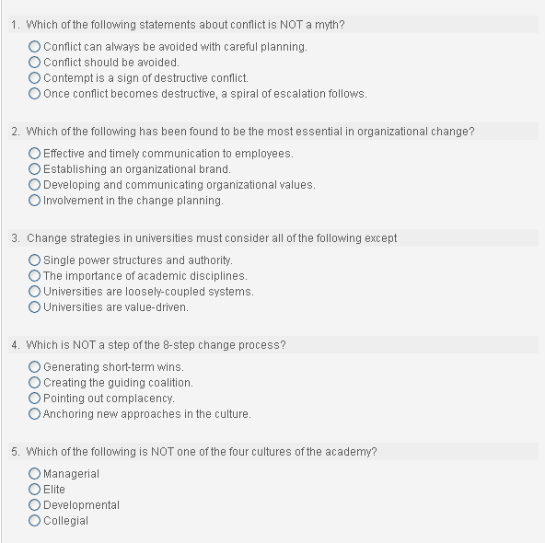
Managing Conflict & Change
Pre/Post Test

Slide 41
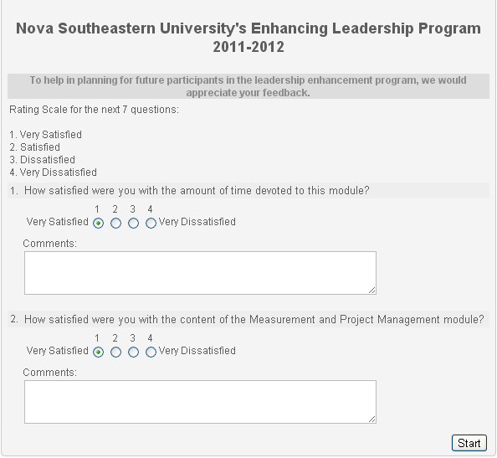

Slide 42
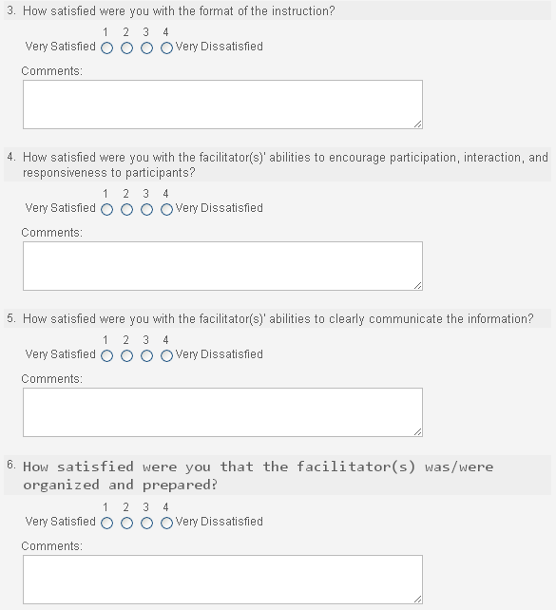

Slide 43
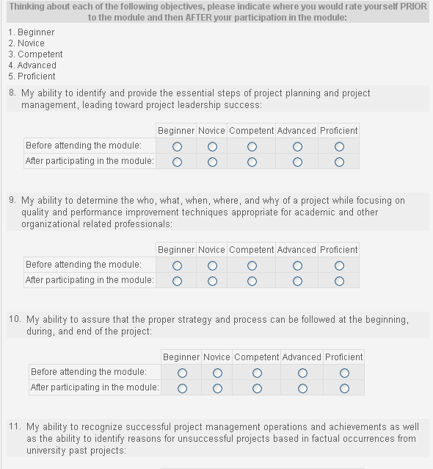

Slide 44
feedback
What are they saying about it?

Slide 45
Comments
All staff would greatly benefit from this module
This was so helpful to me. Want to invite her to speak to our division.
I came away with some valuable management information.
A bit more on how each of us would use the material....time for us to apply it to our work environment.
Important information, would have liked to have my supervisors in the same room with me.
I've already adapted it in my day-to-day interactions with others.
Dr. McKay's style and delivery was fantastic. So knowledgeable on the subject matter.
Judy has an engaging teaching style. Her personal experiences as an attorney added value to program.
Judith was excellent! She kept it moving and real.
How it related to my day to day activities as well as the change that is happening throughout the university.
The information about conflict within an organization and understand the concept of change was very good.
The facilitator and her real life stories used as examples
All material was beneficial.

Slide 46
Challenges
What have we had to contend with?

Slide 47
Challenges
Mandatory or not?
Facilitator problems
Diversity issue (stand alone module or infusion)
Tracking attendance
Food
Hybrid Class – use of Blackboard
Video-teleconferencing to distant sites
Dissertation student - IRB
Sustainability

Slide 48
Discussion!
What do you want to know that we haven’t told you yet?

Slide 49
Contact Information:
Barbara Packer-Muti, Ed.D.
Executive Director, Institutional & Community Engagement
packerb@nova.edu
and
Meline Kevorkian, Ed.D.
Assistant Provost, Academic Affairs
melinek@nova.edu

