Slide 1
Integrated, Systematic Planning and Evaluation: An Evidence-Based Approach to Compliance with CR2.5 George L. Hanbury II, Ph.D. President and CEO Nova Southeastern University Donald J. Rudawsky, Ph.D. Executive Director for Institutional Effectiveness Nova Southeastern University

Slide 2
Abstract
Compliance with CR2.5 requires that an institution demonstrate engagement in planning and evaluation processes that result in continuous improvement in institutional quality. Institutions must demonstrate that these processes are integrated, institution-wide, research-based, and systematic. This session will explore what it means to have integrated, institution-wide, research-based, and systematic planning and evaluation processes by highlighting how one institution applied this principle to its pursuit of a new Vision for 2020.

Slide 3
Objectives of the Session
Connect planning, evaluation, mission, and improvement
Demonstrate planning across multiple units
Demonstrate development of a cohesive set of strategic priorities with performance targets
Highlight dashboards that facilitate ongoing improvement
Notes:
Reinforce the importance of ensuring an integrated, university-wide, systematic, and research-based approach to planning and evaluation to foster continuous improvement, facilitate fulfillment of institutional mission, and comply with CR2.5
Demonstrate the various mechanisms by which a large, diverse institution may integrate its planning efforts across multiple units and an array of perspectives
Demonstrate how a process that incorporates extensive collaboration, deliberation and consensus may result in a cohesive set of strategic priorities with performance targets and initiatives derived from the mission
Highlight how an evidence-based approach, facilitated by the use of dashboards, will facilitate ongoing institutional improvement

Slide 4
Session Outline
Nova Southeastern University Overview
Leadership at NSU
Opportunities and Challenges
Development of Vision, Mission, Core Values, and Strategic Priorities
Assessment
Benefits of Strategic Planning and Relation to CR 2.5

Slide 5
Nova Southeastern University Overview
8th Largest Private, Non-Profit in the United States (Fall 2010)
Almost 80% Graduate or Professional Students
  6,297 Undergraduate
  18,135 Graduate
  3,925 Professional
  28,457 Total
Growth of over 30% in last 10 years
17 Academic Units

Slide 6

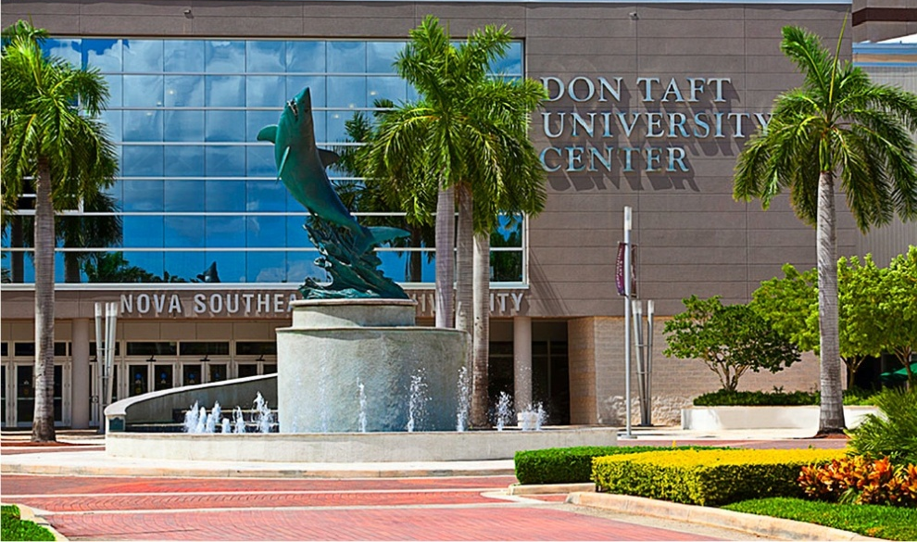
Nova Southeastern University Campus

Slide 7
New Leadership
In 2011, Dr. Hanbury was inaugurated as President and CEO
Dr. Hanbury had served as Vice President of Finance and CFO for 12 years prior

Slide 8
Opportunities and Challenges
Communication
One NSU
Developing a Shared Vision, Mission, and Core Values and Uniting NSU around Achieving that Vision

Slide 9
NSU Employee Engagement
NSU has been conducting Employee Engagement surveys regularly since 2007
Response rates over 70%
One area of Opportunity is in Communication

Slide 10

Communication presents a general Opportunity at NSU
One's own unit's is perceived to perform better than others.
Unfettered communication with the administration is among the most polarized items on the survey. This may represented unequal access or exposure to leadership.
Information flowing from leadership is perceived favorably by some and unfavorably by others.
This item sets "a high bar for agreement". Still, one-third agreed while one-fourth disagreed.

Slide 11
A New Leader – A New Shared Vision
During 2010 and 2011, Dr. Hanbury conducted year-long series of meetings with 4,000+ NSU stakeholders
In 2011, Dr. Hanbury was inaugurated as NSU’s sixth President and CEO
A SET OF UNIVERSITY CORE VALUES EMERGED

Slide 12
NSU Team 2020
From many independent silos to one integrated system
From a confederacy of academic and administrative units to an “E Pluribus Unum University” ("Out of many, one")
From independent and isolated strategic planning to collaborative and cooperative strategic planning

Slide 13
Vision 2020
“A beacon for directing NSU’s future”
A new Mission emerged from the Vision
By 2020, through excellence and innovations in teaching, research, service, and learning, Nova Southeastern University will be recognized by accrediting agencies, the academic community, and the general public as a premier, private, not-for-profit university of quality and distinction that engages all students and produces alumni who serve with integrity in their lives, fields of study, and resulting careers.

Slide 14
Mission
foundation for planning
The mission of Nova Southeastern University, a private, not-for-profit institution, is to offer a diverse array of innovative academic programs that complement on-campus educational opportunities and resources with accessible distance-learning programs to foster academic excellence, intellectual inquiry, leadership, research, and commitment to community through engagement of students and faculty members in a dynamic, lifelong learning environment.
Notes:
Now, with that Mission established, the university set forth on a path toward realizing the Vision.

Slide 15
NSU’s Core Values
“The Essence of NSU”
The Core Values Inspired a New Vision
Opportunity
Academic Excellence
Student
Centered
Integrity
Innovation
Community
Diversity
Scholarship/
Research
Notes:
Dr. Hanbury gave stakeholders across the university an opportunity to fine tune our perception of “who we are” – to clarify the message we project about what is important to NSU.
The “essence of NSU” came through in the Core Values we articulated together.
And these, in turn, inspired a common Vision.

Slide 16
“Ground Rules” for NSU Planning
A process that is broadly participatory
intentional, and meaningful to all stakeholders
A process that is conducted with integrity and the best interests of NSU
A process that engages participants in iterative review and assessment
A process informed by the Values, Vision, and Mission; stakeholder needs/interests; changes in the higher education arena; DATA, DATA, DATA
Notes:
Effective planning requires a structured, informed approach that is intentional and meaningful.
It requires broad participation.
It’s design and conduct must reflect integrity.
And, it must be founded and furthered based on data.
Those are the ground rules we followed and will continue to follow as we transition from development to implementation.

Slide 17
Integration with Existing Planning and Assessment Procedures
Academic Program Review
Quality Improvement Plan
Quality Enhancement Plan
Performance Based Budgeting

Slide 18
What We Have Accomplished
Preliminary unit-specific business plans
Planning Coalesced around 6 Strategic Priorities
Units “retreated”
for
deliberation
and
consensus
around
Core Values, Vision,
Mission
Plans refined in context of Core Values
Identified the most compelling areas on which to focus NSU’s resources
Notes:
NSU is large, mature, and diverse enough that many of the theories of leadership and the varying leadership styles discussed in the Blackboard session might be used to explain why we have succeeded as an institution.
Let’s look at how we have managed to mesh perspectives without compromising our diversity.
A first step was development of business plans at the unit level. Many of you participated in that activity.
Each unit’s plan was informed by differing perspectives and the varying contexts in which the units operate.
The next steps called upon units to refine their plans in the context of our Core Values, Vision, and Mission, which culminated in our consensus-building at the retreats last summer.
Compelling, but diverse areas of need were integrated across units and coalesced around 6 Strategic Priorities

Slide 19
NSU’s Strategic Priorities
Strategic Priority 1
Enhance Student Performance/ Engagement/Retention
Strategic Priority 2
Enhance Academic Program Quality
Strategic Priority 3
Strategic Priority 4
Strategic Priority 5
Strategic Priority 6
Increase Nontuition Funding
Improve Incoming Undergraduate Student Quality
Enhance Targeted Recruitment
Enhance Faculty Quality

Slide 20


Slide 21
Achieving Vision 2020
Strategic Priority
Performance Measures
Baseline: 2010
Targets:
Strategic Initiatives
2012-2015
2015
2020

Slide 22
Continuous Assessment and Feedback
Key Performance Indicators Developed for each Strategic Priority
Goals set for 2015 and 2020
Tracked through Dashboards

Slide 23
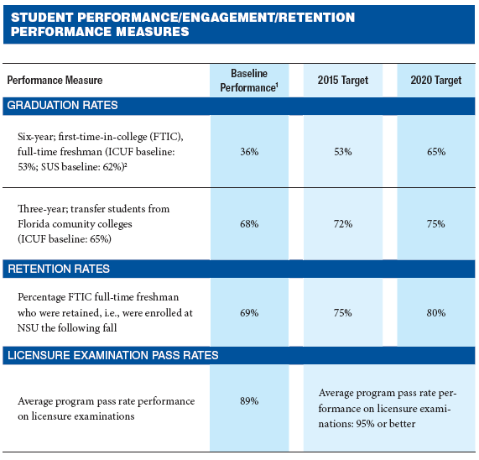
Example of Performance Measures

Slide 24
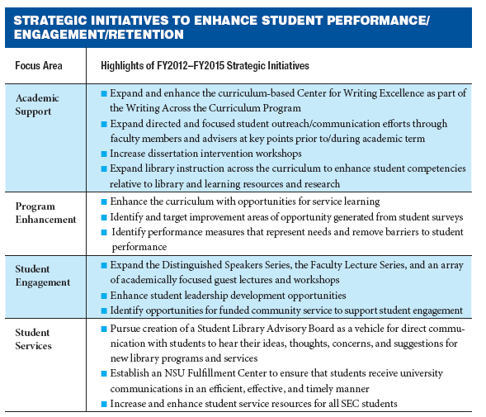
Example of Strategic Initiatives

Slide 25
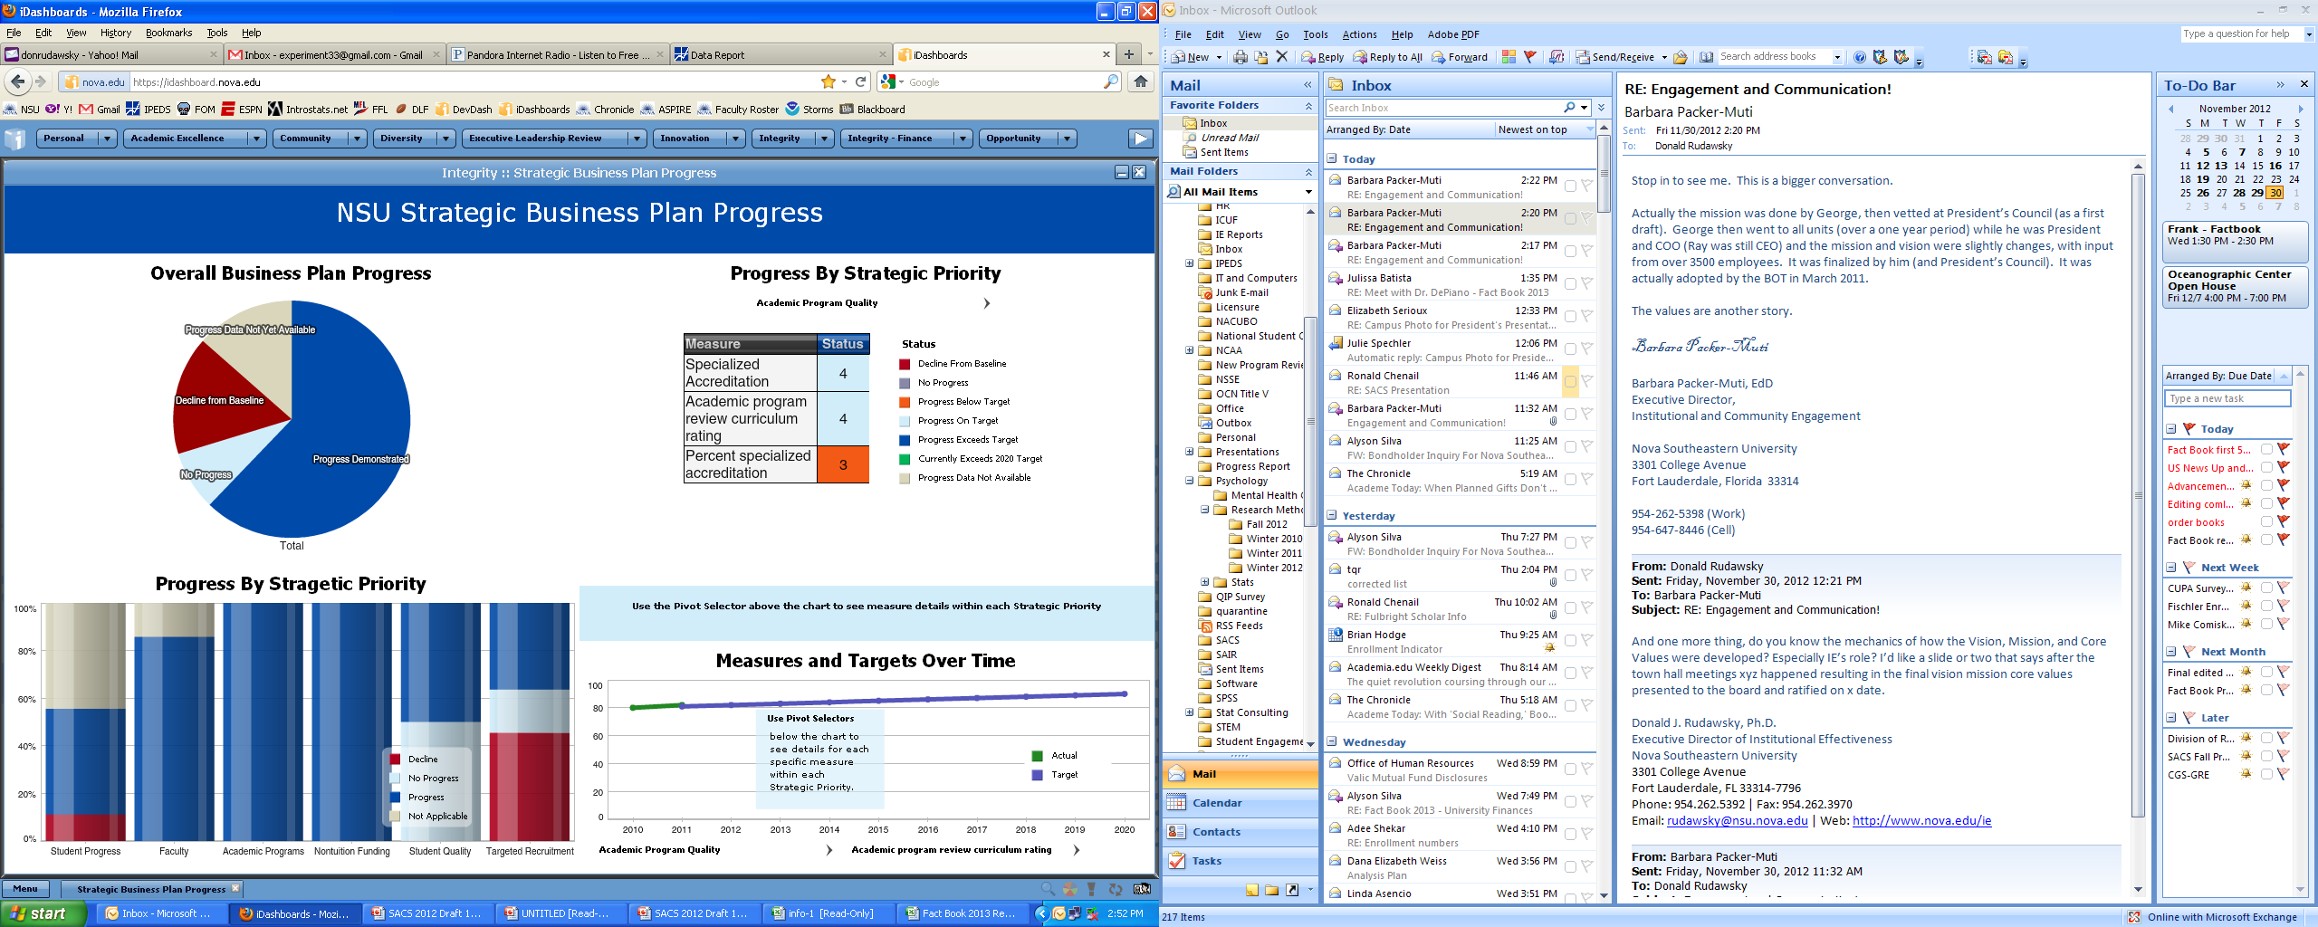
Strategic Priorities Dashboard

Slide 26
Strategic Priorities Dashboard

Slide 27
Strategic Priorities Dashboard

Slide 28
Strategic Priorities Dashboard

Slide 29
Strategic Priorities Dashboard

Slide 30
Beyond Compliance: Institutional Benefits of Integrated, Systematic Processes

Slide 31
Benefits of Having a Strategic Plan
Define Purpose
Establish Goals and Objectives
Time Bound
Notes:
These are the Benefits of having a strategic plan

Slide 32
Benefits in the Creation of the Strategic Plan
Gathering information and opinion from throughout the institution
Develop stakeholder ownership of the plan
Build consensus among staff and faculty from all units
Notes:
These are the Benefits of creating a strategic plan

Slide 33
Benefits in Implementation of the Strategic Plan
Provide a starting point for measurement and evaluation
Provides focus, which increases productivity
Ensure effective use of resources
Satisfaction and Pride
Notes:
These are the Benefits of implementing a strategic plan:
1.
2. Through increased efficiency and effectiveness
3. Focusing resources on key priorities
4. Camaraderie among planners, which is everyone, and communicate the final plan to everyone to be proud of and guide work.

Slide 34
Core Requirement 2.5
The institution engages in ongoing, integrated, and institution-wide research-based planning and evaluation processes that (1) incorporate a systematic review of institutional mission, goals, and outcomes; (2) result in continuing improvement in institutional quality; and (3) demonstrate the institution is effectively accomplishing its mission. (Institutional Effectiveness)

